Slide 1


WELCOME
The secret lives of Open Source Designers.
Summary of diary studies of designers contributing to OSS
Eriol Fox they/them
https://github.com/simplysecure/Diary-Studies-Designers-in-OSS

Slide 2

Superbloom is committed to changing who technology serves by leveraging design to shift power.
You may know us as Simply Secure, our former name.
https://github.com/simplysecure/Diary-Studies-Designers-in-OSS
Notes:
Superbloom is a design and research nonprofit that is changing who technology serves. We do this by leveraging design to shift power in the tech ecosystem. You may know us as Simply Secure.

Slide 3
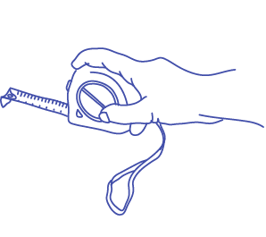




We design for…
… high-risk communities in remote, hard-to-reach, poorly connected regions to safely give user feedback.
… funders to best support sustainable critical digital infrastructure.
… open design and open source design to become normalised in tool creation, improvement and growth.
https://github.com/simplysecure/Diary-Studies-Designers-in-OSS
Notes:
We are an international team with expertise in research, design, software development, and product management, supported by a diverse set of advisors and partners.
We have been working in internet freedom, human centered design, and public interest technology since we were founded as Simply Secure in 2015.
Recently, we’ve been tackling some particular sticky design problems across security, policy, and community. We tackled questions like:
How do we design for quick, user-oriented solutions for high-risk communities in remote, hard-to-reach, poorly connected regions, in a global pandemic?
How is the new user onboarding processes for decentralized apps different for technical & non-technical users?
How can funders best support the sustainability of our critical digital infrastructure?
How can we move beyond dark patterns and deceptive design, toward a vision for trusted design?
We’ve learned a lot answering these questions, and have some grounding themes to share.

Slide 4
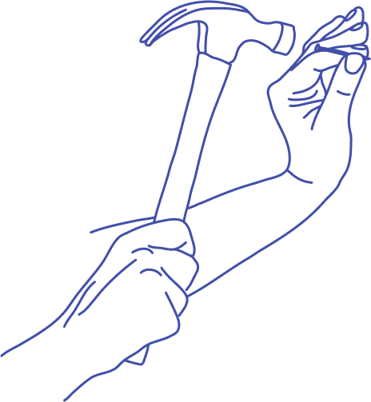

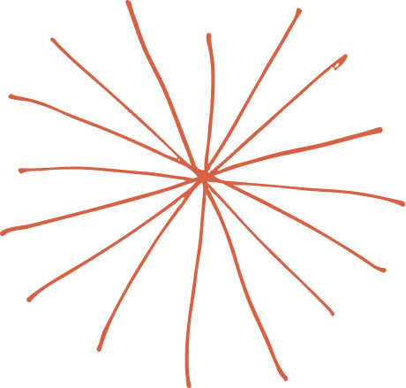


Some of our projects
Deceptive Design: Moving Towards Trusted Design Patterns -
https://techlab.webfoundation.org/deceptive-design/overview
“User Testing can Be Fun” - a set of visual and interactive resources on user testing for open source developers - https://simplysecure.github.io/devs-guide-to/
USER - Sloan Foundation grant to study usability practices in open source scientific software projects - https://user-project.superbloom.design/
Building Blocks - a toolkit for funders to better understand and support critical infrastructure projects - https://buildingblocks.simplysecure.org/
https://github.com/simplysecure/Diary-Studies-Designers-in-OSS
Notes:
Creating open resources is at the heart of what we do. Human-centered design methods allow us to co-design tools and processes alongside the communities that will use and benefit from them.
Partnering with Internews and OKThanks, we created a set of visual and interactive resources on user testing for open source developers.
Continuing to promote developer/designer collaboration, we we were lucky to receive a grant from the Sloan Foundation to study how scientific open source software projects think about their users, work with designers, and prioritize usability.
And earlier this year, we launched Building Blocks, a toolkit for funders to better understand and support critical digital infrastructure projects to promote sustainability

Slide 5

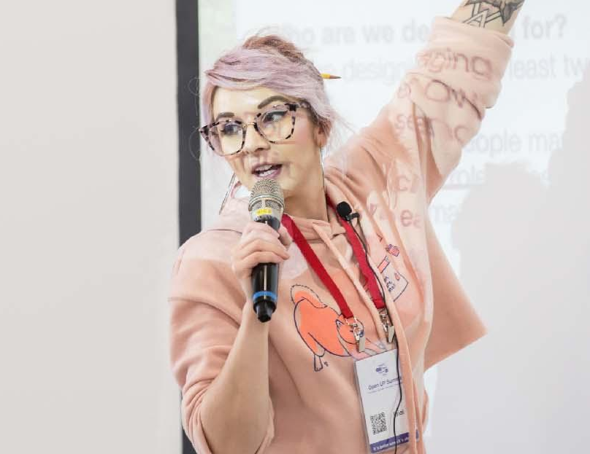
Hi, I’m Eriol. (Ehh-roll).
They/Them pronouns.
12+ years in digital product design and UX.
5-6 years in open source software (OSS).
1.5 years at Superbloom.
PhD (@Newcastle) researching how design is done and how designers are involved in Humanitarian & Human Rights OSS.
senior designer and researcher
eriol fox
@erioldoesdesign
eriol@superbloom.design
https://github.com/simplysecure/Diary-Studies-Designers-in-OSS

Slide 6

In 2022, Vermont Complex Systems Center at The University of Vermont awarded Superbloom an OCEAN grant (Open-Source Ecosystems and Networks Research Awards program) to investigate and give designers (who are currently contributing to OSS) an opportunity to describe their experiences in a safe environment and through anonymous, privacy respecting means.
A
B
O
U
T
T
H
E
D
E
S
I
G
N
E
R
D
I
A
R
Y
S
T
U
D
y
https://github.com/simplysecure/Diary-Studies-Designers-in-OSS
Notes:
In 2022, Vermont Complex Systems Center at The University of Vermont awarded Superbloom an OCEAN grant (Open-Source Ecosystems and Networks Research Awards program) to investigate and give designers (who are currently contributing to OSS) an opportunity to describe their experiences in a safe environment and through anonymous, privacy respecting means.

Slide 7
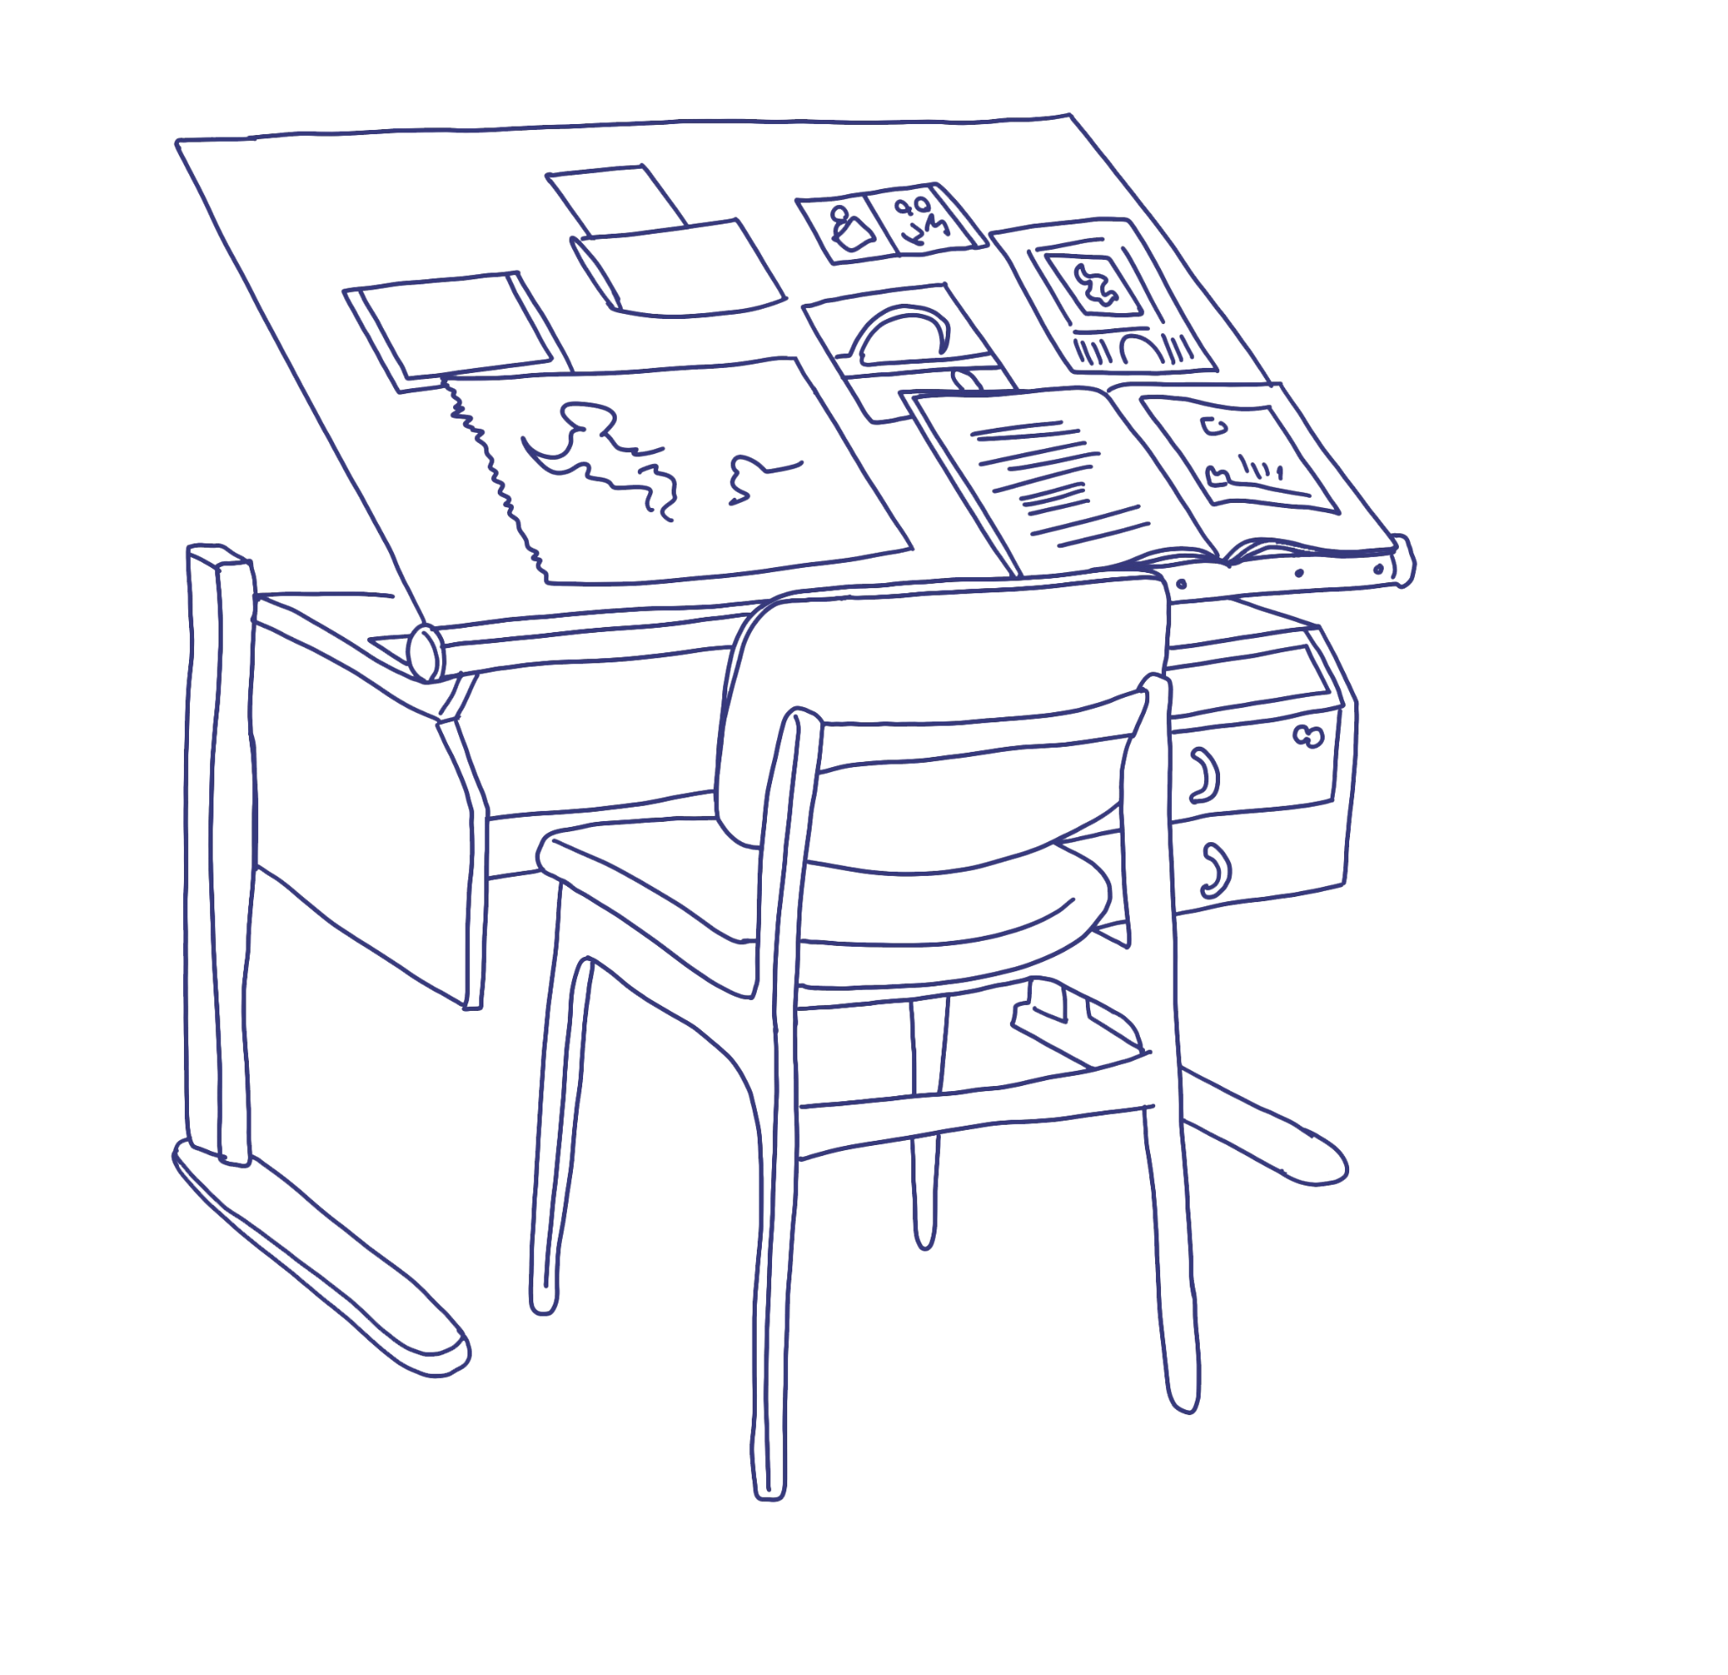
Research aims
R
E
S
E
A
R
C
H
A
I
M
s
This short research project aimed to investigate some key questions related to design in OSS and fill some of the larger systemic "gaps" of information from non-code contributors' experiences in OSS.
Design is sometimes done by developers and sometimes by those with design skills. It’s difficult to understand where these roles and boundaries lie and with whom, and what are optimal conditions for success.
https://github.com/simplysecure/Diary-Studies-Designers-in-OSS

Slide 8
Research questions
R
E
S
E
A
R
C
H
A
I
M
s
What are the experiences that designers contributing to OSS commonly have?
What are the conditions that can set designers up for success within OSS projects, specifically regarding "contributions of design"?
What conditions create a sense of inclusion, both at the project and community scales, for designers in OSS?
What is a design contribution and how is human centered design understood within OSS communities?
How do designers and OSS project developers/maintainers/communities describe "successful" design contributions?
How do designers describe a "successful" relationship with OSS project developers/maintainers/communities around their OSS project?
https://github.com/simplysecure/Diary-Studies-Designers-in-OSS
Notes:
What are the experiences that designers contributing to OSS commonly have?
What are the conditions that can set designers up for success within OSS projects, specifically regarding "contributions of design"?
What conditions create a sense of inclusion, both at the project and community scales, for designers in OSS?
What is a design contribution and how is human centered design understood within OSS communities?
How do designers and OSS project developers/maintainers/communities describe "successful" design contributions?
How do designers describe a "successful" relationship with OSS project developers/maintainers/communities around their OSS project?

Slide 9

Study Structure
We started off the study with a series of semi-structured interviews lasting approximately 45 minutes. Here we asked critical background questions such as:
How did you start in OSS?
How did you start in Design?
What OSS do you contribute to and participate in?
How do you decide on a project that they’d like to work on/contribute to?
Do you contribute to OSS as part of a paid role, volunteer (free) or both? In what ratio? How does paid/volunteer OSS work feel to you?
etc…
https://github.com/simplysecure/Diary-Studies-Designers-in-OSS

Slide 10
Who we studied and what OSS they contributed to
We published an open call for designers to participate in a diary study and selected as many globally distributed people as possible.
Our participants were from and reside in: Canada, USA, Nigeria, Brazil and the Netherlands.
Our participants were sixty percent women identifying and forty percent man identifying.
Sixty per cent of participants were early in their design (and OSS) careers, forty percent
were postgraduate students.
All of our study participants had been contributing to OSS for at least one year.
https://github.com/simplysecure/Diary-Studies-Designers-in-OSS

Slide 11
Participant ID | Part Time / Full Time | Employment Status (Contract, Staff, Self-employed, etc) | Student (postgraduate) | OSS Projects contributed to
Grey | FT | Self-employed | No | 2-3
Pink | PT | Contract | Yes | 3
Yellow | FT | Staff | No | 3-5
Green | FT | Self-Employed Contracts | No | 4-6
Blue | FT | Staff | Yes | 2-3
https://github.com/simplysecure/Diary-Studies-Designers-in-OSS
Notes:
In this short talk, we'll give an overview of our findings but specifically zoom in on the ways in which Scientific and Research OSS (S&R OSS) contributors/teams leverage community spaces, interactions and documents to make user-informed choices about how to make their documentation and tools better. There will then be a critical review of how design research trained individuals might iterate and improve on these practices to make usability and design even better in S&R OSS.

Slide 12
Find out about:
How these designers first become involved in OSS.
How designers decide to contribute to an OSS project.
What tools designers use when contributing to OSS.
What artifacts were shared across the sixteen weeks.
In the longer findings document: github.com/simplysecure/Diary-Studies-Designers-in-OSS
https://github.com/simplysecure/Diary-Studies-Designers-in-OSS

Slide 13
Designer-developer collaboration
Designer and developer involvement and collaboration was a recurring theme in the diary study.
At some point, all designers used GitHub or GitLab - traditionally seen as tools for developers - for communication and collaboration with developers. However, the participants also mentioned struggling with the tools.
https://github.com/simplysecure/Diary-Studies-Designers-in-OSS

Slide 14
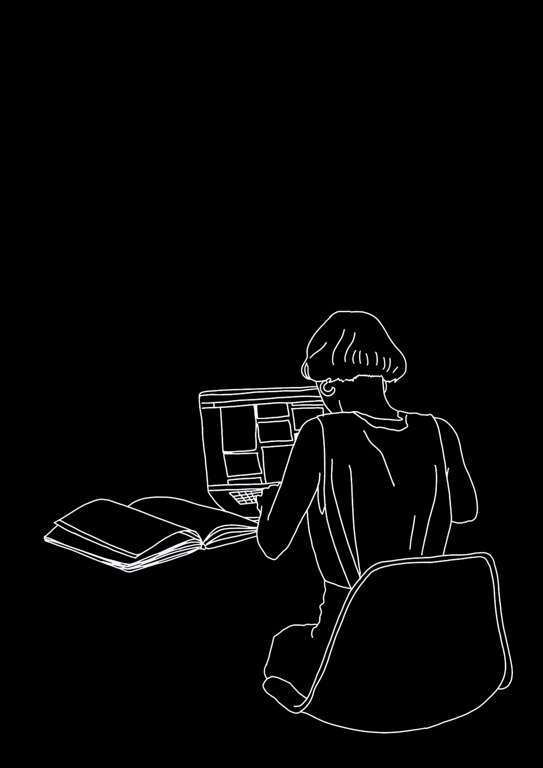
“(I’m) not sure the best way to use GitLab for design tickets.” “
“I hate GitLab, it is confusing and the team did not put me as (a) developer yet.”
https://github.com/simplysecure/Diary-Studies-Designers-in-OSS
Notes:
Onboarding in particular is a responsibility that is passed off to communities of users. For instance, the burden of teaching a tool is often on professors, researchers, or students to teach each other. Tool feedback and troubleshooting – key components of user research – happens organically in user community channels such as Slack, Discourse, community calls, etc. Projects teams that are active and responsive in user channels are participating in informal user research, whether they recognize these user research methods or not.

Slide 15
Designer-developer collaboration
Conversely, developers were more involved in the design process, with designers “Getting responses from developers about design proposals”.
All designer participants mentioned getting feedback from the developers as a crucial step in their process.
https://github.com/simplysecure/Diary-Studies-Designers-in-OSS

Slide 16
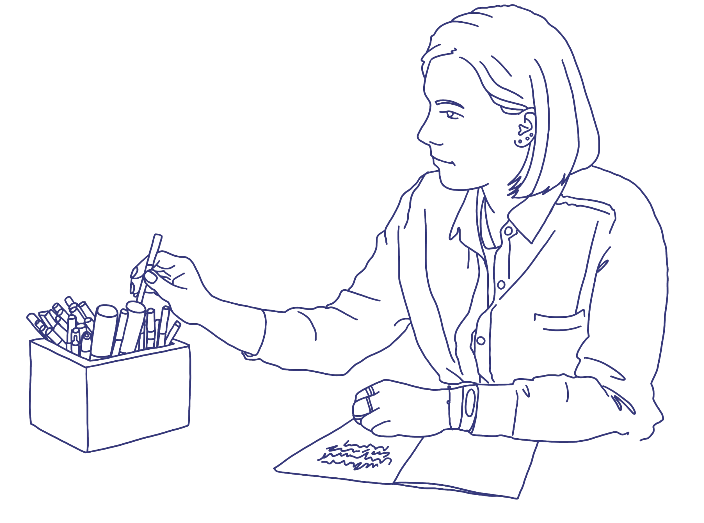
“(I) made a user-flow diagram to make my designs more comprehensible”.
“A developer found my organized Figma files useful”.
https://github.com/simplysecure/Diary-Studies-Designers-in-OSS

Slide 17
Openness practices
Designer participants share assets and resources with their community and other stakeholders in an effort to be more open.
One participant mentioned migrating to an open source tool to be more open, and they also reported having issues with the previous, not OSS design tool.
“I’m on the way! Using Penpot and not Figma, maybe?”
“Penpot can not navigate between pages yet”.
https://github.com/simplysecure/Diary-Studies-Designers-in-OSS

Slide 18
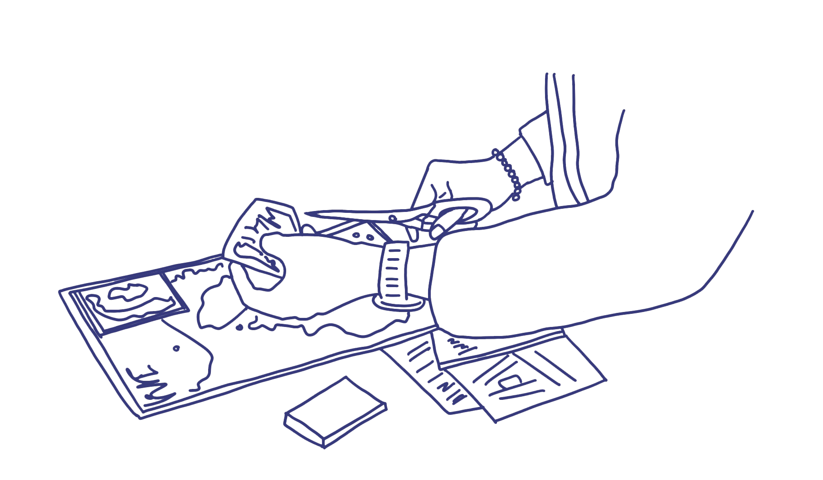
“I heard back from someone I shared open design resources with that it was helpful and that they will be using our contributions”.
https://github.com/simplysecure/Diary-Studies-Designers-in-OSS

Slide 19
Openness practices
The motivations for being open seem to follow some general themes. Designer participants who share their assets and resources do so for easier collaboration with stakeholders.
Another motivation for sharing assets was to have more involvement from the community, as one participant “shared the doc with the team at (OSS community organization) for other designers to make inputs”.
https://github.com/simplysecure/Diary-Studies-Designers-in-OSS

Slide 20
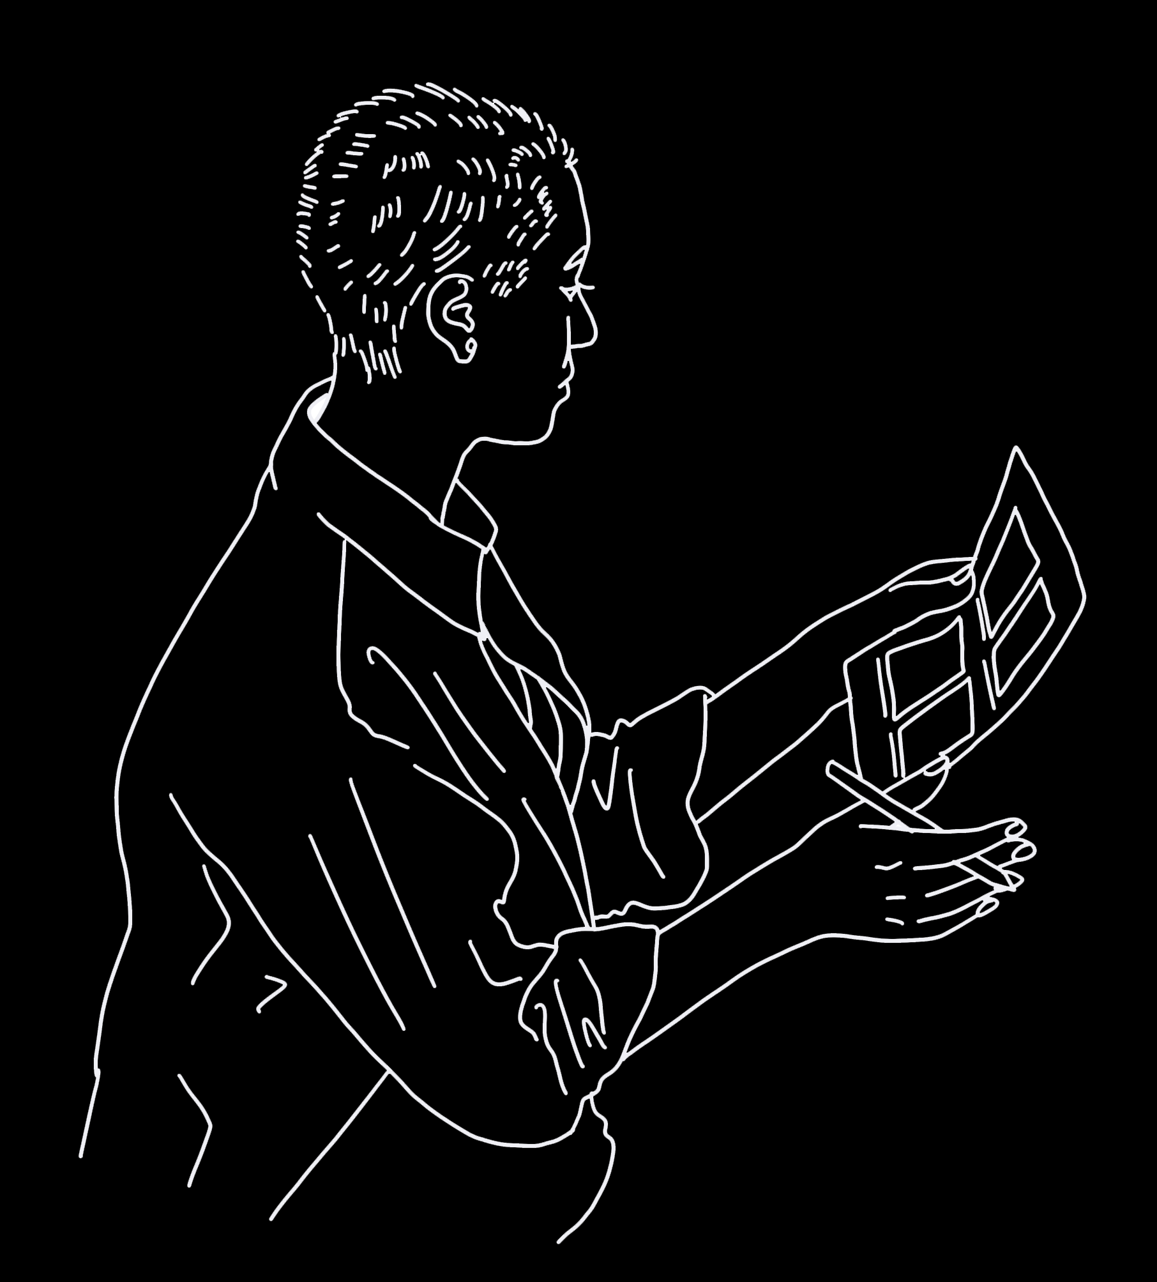
“Apart from my design contributions, I also had conversations with other open source designers and project owners on the future of design in OSS for 2023.”
https://github.com/simplysecure/Diary-Studies-Designers-in-OSS
Notes:
Onboarding in particular is a responsibility that is passed off to communities of users. For instance, the burden of teaching a tool is often on professors, researchers, or students to teach each other. Tool feedback and troubleshooting – key components of user research – happens organically in user community channels such as Slack, Discourse, community calls, etc. Projects teams that are active and responsive in user channels are participating in informal user research, whether they recognize these user research methods or not.

Slide 21
Designers speaking about success
Success via feedback
Success via completion of design and/or "live release"
Success via knowing what is a priority for the OSS
Success via attracting more designers to the OSS
Success via acknowledgement, inclusion and collaboration
Success via accessibility and usability
https://github.com/simplysecure/Diary-Studies-Designers-in-OSS

Slide 22
D
E
S
I
G
N
E
R
S
S
P
E
A
K
I
N
G
A
B
O
U
T
S
U
C
C
E
S
s
Success via feedback
The designers saw their work as successful when the feedback they received as relevant and useful.
Designers tend to assume “they’ve got it right” (i.e. are successful) if there are no questions or feedback on their design work. This was less so if the designer did not seem particularly confident about their proposed design.
Participants also viewed “slow” feedback negatively – the lack of communication was seen as a progress blocker.
https://github.com/simplysecure/Diary-Studies-Designers-in-OSS

Slide 23
“When I get feedback on what's wrong in my design and get next steps that are actionable”.
“There was a delay in feedback from my prior conversations with the maintainer, and I was unable to kick off immediately”
https://github.com/simplysecure/Diary-Studies-Designers-in-OSS

Slide 24
Designers speaking about success
Success via feedback
Success via completion of design and/or "live release"
Success via knowing what is a priority for the OSS
Success via attracting more designers to the OSS
Success via acknowledgement, inclusion and collaboration
Success via accessibility and usability
https://github.com/simplysecure/Diary-Studies-Designers-in-OSS

Slide 25
D
E
S
I
G
N
E
R
S
S
P
E
A
K
I
N
G
A
B
O
U
T
S
U
C
C
E
S
s
Success via completion of design and/or "live release"
All designers universally celebrated contributions that went "live" in a "finished" way such as websites being accessed by the public/people outside of the project.
However, most designers were unsure when something would go live if they were unable to control the process and actually publish the work themselves.
Designers also expressed frustration around design that, in their opinion, was ready to go live but instead was held up by rounds of approval or at worst, by developers or maintainers requesting design changes.
https://github.com/simplysecure/Diary-Studies-Designers-in-OSS

Slide 26
“Not sure which designs will be implemented when, since we're not using product management strategies”
https://github.com/simplysecure/Diary-Studies-Designers-in-OSS

Slide 27
Designers speaking about success
Success via feedback
Success via completion of design and/or "live release"
Success via knowing what is a priority for the OSS
Success via attracting more designers to the OSS
Success via acknowledgement, inclusion and collaboration
Success via accessibility and usability
https://github.com/simplysecure/Diary-Studies-Designers-in-OSS

Slide 28
D
E
S
I
G
N
E
R
S
S
P
E
A
K
I
N
G
A
B
O
U
T
S
U
C
C
E
S
s
Success via knowing what is a priority for the OSS
Measuring progress on priorities was difficult and one designer spoke consistently of the need for a product or project manager to guide them to the highest priority task.
Designers employed a lot of tactics in order to better understand priorities in the absence of a documented roadmap or plan for the OSS, or when the OSS plan exists in a single mind or collective of OSS community members' minds.
Designers commented that there were “no clear roadmaps for implementation” of the OSS and that while issues and meetings presented a pathway, these were not always coherent or indicative of any wider objectives.
https://github.com/simplysecure/Diary-Studies-Designers-in-OSS

Slide 29
“Not much of a hack, but I've started to get important stakeholders (often project leads) to sketch out their ideas more so that I know what they're thinking”.
https://github.com/simplysecure/Diary-Studies-Designers-in-OSS
Notes:
Onboarding in particular is a responsibility that is passed off to communities of users. For instance, the burden of teaching a tool is often on professors, researchers, or students to teach each other. Tool feedback and troubleshooting – key components of user research – happens organically in user community channels such as Slack, Discourse, community calls, etc. Projects teams that are active and responsive in user channels are participating in informal user research, whether they recognize these user research methods or not.

Slide 30
Designers speaking about success
Success via feedback
Success via completion of design and/or "live release"
Success via knowing what is a priority for the OSS
Success via attracting more designers to the OSS
Success via acknowledgement, inclusion and collaboration
Success via accessibility and usability
https://github.com/simplysecure/Diary-Studies-Designers-in-OSS

Slide 31
D
E
S
I
G
N
E
R
S
S
P
E
A
K
I
N
G
A
B
O
U
T
S
U
C
C
E
S
s
Success via attracting more designers to the OSS
Designers expressed joy when they got to work with other designers and other contributors on design tasks in the OSS projects that they contributed to.
When gathering collaborators in OSS for design tasks there is an awareness from designers already in OSS that most designers are newer and looking to gain certain types of experience with their contributions.
Future hopes for a specific OSS project in this study, is that increasing designers working on OSS design tasks would “Reduce the pressure on me and the other active contributors”.
https://github.com/simplysecure/Diary-Studies-Designers-in-OSS

Slide 32
This is a challenge because most designers looking to contribute are new designers and are contributing to open source to gain experience”.
"(I) want to do actual design work"
https://github.com/simplysecure/Diary-Studies-Designers-in-OSS

Slide 33
Designers speaking about success
Success via feedback
Success via completion of design and/or "live release"
Success via knowing what is a priority for the OSS
Success via attracting more designers to the OSS
Success via acknowledgement, inclusion and collaboration
Success via accessibility and usability
https://github.com/simplysecure/Diary-Studies-Designers-in-OSS

Slide 34
D
E
S
I
G
N
E
R
S
S
P
E
A
K
I
N
G
A
B
O
U
T
S
U
C
C
E
S
s
Success via acknowledgement, inclusion and collaboration
Positive comments were given to all designers across the duration of the diary study. Comments were specific to designs, and some were directly from users who were excited about improvements to the OSS as a result of involvement in usability testing and design.
To compound the difficulty with inclusion and collaboration in OSS, designers often struggle to assert themselves in collaboration situations where developers, maintainers and users speak at length about particular issues or topics, and the designer doesn’t always feel empowered to steer back to what they need to make their design contribution successful.
https://github.com/simplysecure/Diary-Studies-Designers-in-OSS

Slide 35
“I received a very positive response on the logo designs I've worked on for the OSS project and dates are planned for the launch of new logos”.
“I noticed if you are not part of a community it is difficult to contribute as a designer”.
https://github.com/simplysecure/Diary-Studies-Designers-in-OSS
Notes:
Onboarding in particular is a responsibility that is passed off to communities of users. For instance, the burden of teaching a tool is often on professors, researchers, or students to teach each other. Tool feedback and troubleshooting – key components of user research – happens organically in user community channels such as Slack, Discourse, community calls, etc. Projects teams that are active and responsive in user channels are participating in informal user research, whether they recognize these user research methods or not.

Slide 36
Designers speaking about success
Success via feedback
Success via completion of design and/or "live release"
Success via knowing what is a priority for the OSS
Success via attracting more designers to the OSS
Success via acknowledgement, inclusion and collaboration
Success via accessibility and usability
https://github.com/simplysecure/Diary-Studies-Designers-in-OSS

Slide 37
D
E
S
I
G
N
E
R
S
S
P
E
A
K
I
N
G
A
B
O
U
T
S
U
C
C
E
S
s
Success via accessibility and usability
Comments made by designers were about their approach to practicing design and noticing these moments when accessibility and usability were missing.
In a general sense, designers try to encapsulate the voices of the users, which is inclusive of their accessibility and usability struggles. “I generally try to be the voice of the user”.
https://github.com/simplysecure/Diary-Studies-Designers-in-OSS

Slide 38
“We have set accessibility goals for the project, once we meet all of them, we can say the project was successful”.
https://github.com/simplysecure/Diary-Studies-Designers-in-OSS

Slide 39
Find out about:
The long cycle of communication in OSS
Processes: who makes decisions and how are they made?
Who are the "users'?
Dealing with an overwhelming amount of design work
Being paid for OSS contributions
Designers in OSS and their busy lives
In the longer findings document: github.com/simplysecure/Diary-Studies-Designers-in-OSS
https://github.com/simplysecure/Diary-Studies-Designers-in-OSS

Slide 40
What might make designers leave an OSS project?
The designers of the diary study had many challenges, mostly centering around communications, delegation, project/product management and the value of their work compared to time invested by them.
Designers often expressed disappointment when all of their time was spent on annotating specific details of a design artifact or document (e.g. This button in a UI does X, this usability study means that we know X about users etc.) or justifying why design should be done in the OSS.
https://github.com/simplysecure/Diary-Studies-Designers-in-OSS

Slide 41
Designers want seven things to be present before they leave an OSS project:
S
U
C
C
E
S
S
I
O
N
P
L
A
N
N
I
N
G
D
E
S
I
G
N
The design work is done and continues to be done in open design software (so not proprietary closed software such as Adobe). However, these open source design tools are stated as "not as good as closed tools.
The design is left in a way that other people can pick up and understand.
To leave the OSS in "a better place" in terms of design (this would be unique and specific to each OSS).
To ensure that the OSS maintainers know how and what was done and the project is handed over slowly and carefully. Do not “ghost" and help knowledge be sustained
https://github.com/simplysecure/Diary-Studies-Designers-in-OSS
Notes:
What are the experiences that designers contributing to OSS commonly have?
What are the conditions that can set designers up for success within OSS projects, specifically regarding "contributions of design"?
What conditions create a sense of inclusion, both at the project and community scales, for designers in OSS?
What is a design contribution and how is human centered design understood within OSS communities?
How do designers and OSS project developers/maintainers/communities describe "successful" design contributions?
How do designers describe a "successful" relationship with OSS project developers/maintainers/communities around their OSS project?

Slide 42
Designers want seven things to be present before they leave an OSS project:
S
U
C
C
E
S
S
I
O
N
P
L
A
N
N
I
N
G
D
E
S
I
G
N
To know the design will change after you"ve gone. OSS is about sharing and being willing to accept changes
To plan the structure for the OSS to not just recognise design contributions but document them well too
To inspire designers to get involved in the OSS
Most designers expressed a desire to never fully leave an OSS project and they would ideally stay on in an advisor role and be able to answer questions when needed. For many, participation in OSS was an ethical or socially motivated reason.
https://github.com/simplysecure/Diary-Studies-Designers-in-OSS
Notes:
What are the experiences that designers contributing to OSS commonly have?
What are the conditions that can set designers up for success within OSS projects, specifically regarding "contributions of design"?
What conditions create a sense of inclusion, both at the project and community scales, for designers in OSS?
What is a design contribution and how is human centered design understood within OSS communities?
How do designers and OSS project developers/maintainers/communities describe "successful" design contributions?
How do designers describe a "successful" relationship with OSS project developers/maintainers/communities around their OSS project?

Slide 43
Scaling up and continuing this work
This study was one of the first to capture OSS designers' experiences across multiple weeks and see what patterns and insights we could learn about designers' participation in OSS. There are however, many missing components to this study and many aspects that would benefit the OSS community widely.
1
2
3
Inviting more OSS projects and community members to interviews, including those who collaborate with designers
Better understanding the ways in which different roles view design and designers alongside the purpose of the OSS
Including different types of OSS projects (e.g. OSS with an academic research focus vs OSS that is a developer tool etc)
https://github.com/simplysecure/Diary-Studies-Designers-in-OSS

Slide 44
Emergent Recommendations
As an OSS project interested in receiving design contributions, review and take note of the ways in which designers decide whether to offer design to an OSS project. Some of these indicators for designers include ‘ Is the project clear what problems they want solved by the designer?’ and ‘Is this OSS a one-person project and is it still active?’
See ‘How do designers decide whether they’d like to contribute to or work on an OSS project? ‘ section.
See more recommendations in the findings document: github.com/simplysecure/Diary-Studies-Designers-in-OSS
https://github.com/simplysecure/Diary-Studies-Designers-in-OSS

Slide 45
Emergent Recommendations
Designers measure success in many ways but common these are through healthy feedback cycles with usable suggestions for design, having designs implemented, understanding priorities and who/how decides them, growing the design community sustainably and being acknowledged positively for their contributions.
See ‘Designers speaking about success’ section.
See more recommendations in the findings document: github.com/simplysecure/Diary-Studies-Designers-in-OSS
https://github.com/simplysecure/Diary-Studies-Designers-in-OSS

Slide 46

Thank you!
github.com/simplysecure/Diary-Studies-Designers-in-OSS
We’re looking to fund this research again and invite more designers to participate.
If you’d like to participate please get in contact.
Get in touch
Presentation made in google slides
Illustrations made using procreate on ipad
and adobe illustrator saving as .svg.
Open Fonts used:JetBrains & IBM Plex Mono
@superbloom
contact@superbloom.design
superbloom.design
https://github.com/simplysecure/Diary-Studies-Designers-in-OSS

Slide 47
C
H
A
P
T
E
R
1
This is a
Take-home idea!

